Slide 1
FOR INSTRUCTOR PURPOSES ONLY
instructor notes
Instructor Prep:
Review & modify lesson plan & slide deck
Write learning objectives & relevant information on board
Review Student Roster and Instructor Checklist
Prepare handout to distribute to students.

Slide 2
FOR INSTRUCTOR PURPOSES ONLY
Materials

Slide 3
FOR INSTRUCTOR PURPOSES ONLY
PRE-WORK
• Bring a laptop with Anaconda using Python 2.7 installed. Note: Make sure to choose the Python 2.7 version for your operating system.
• If you are using a PC, also install git-bash terminal.
• Optional: Install a text editor like Sublime Text 3 or Atom on your computer. If you are using Anaconda, Spyder is included in the distribution.

Slide 4
PYTHON PROGRAMMING 101
Greg Baker
Director & Head of AI
IFOST, Queckt, BigInsights

Slide 5
Learning objectives
Data Science 101
Discuss the history of Python
Define how Python compares to other programming languages
Describe the benefits of a Python workflow when looking at data
Demonstrate basic Python programming fundamentals to solve a real world problem
Create a custom learning plan to build your data science skills after this workshop!
Notes:
Learning objectives will frame the class and give students reference points

Slide 6
Data Science 101
PRE-WORK

Slide 7
Pre-WORK REVIEW
Bring a laptop with Anaconda installed. Scroll to your operating system version and click on the install button for Anaconda with Python 2.7.
We will be using Jupyter Notebooks as the main IDE for the workshop. If you have installed Anaconda, then you are ready to go!

Slide 8
PYTHON PROGRAMMING101
OPENING
Notes:
10m
More time won’t make the ideas better, it will just give them more time to feel stressed—have them work quickly and focus in on the most important things.

Slide 9
About Me
Welcome to Python Programming 101!
Here's a bit about me:
Name: Greg Baker
Background: Freelance consultant except for when I worked for google
At GA: I teach data science classes
Fun Fact: I was on the team at CSIRO who developed WiFi. I quit because I thought what they were doing was a bad idea.
Notes:
Provide your name and brief bio, including: your background in python programming, any experience you've had with GA, and one "fun fact" about yourself.

Slide 10
About You
So that Greg knows what to say… let’s talk a bit about you!
Name
What brings you to GA
Current activities
Goals
Have you programmed before?
(Fun fact)

Slide 11
OUR EXPECTATIONS
You're ready to take charge of your learning experience.
You're curious and excited about Python!
You've installed Anaconda with Python 2.7 (or 3.x)

Slide 12
The Big Picture
What we’ll cover:
What is Python and what can Python do for me?
Implementing Python into your workflow
Lists, dictionaries and other types — duck typing
Python Libraries
How to complain about the weather in pictures (graphs in Python)
Python control structures
What sort of code to expect if you are coming along for a data science course

Slide 13
The Big Picture
Why this topic matters:
Programming is a sought-after skill
Python has been gaining popularity (why will see why!)
Why this topic rocks:
Python opens up a door to a variety of opportunities, from data science to research

Slide 14
Introduction
What is PYTHON and What can it do for me?
Notes:
15m

Slide 15
This might be why you want to learn Python

Slide 16
What is Python?
Python programming 101
Created by Guido Van Rossum in 1991
Emphasizes productivity and code readability
The language is easy to pick up and learn
This gentle learning curve brings makes it easier for many to contribute to production level code
Readable code means that almost anyone can pick up a piece of code and understand what it is doing

Slide 17
Some characteristics of python
Byte-code Interpreted language:
There isn’t a step where you “run the compiler”.
Just write your code and run it.
Modules get automatically compiled to “.pyc” files when they are first used.

Slide 18
Some characteristics of python
Layout for scope:
There isn’t a BEGIN / END or { } to group statements
It’s just how much of whitespace indent there is…
if progress == 100:
completed=True
else:
completed=False

Slide 19
Some characteristics of python
Not always developed in a normal IDE:
PyCharm is a popular environment for developers
Many data scientists use Jupyter, though

Slide 20
Some characteristics of python
High-level programming:
You get a lot done without many lines of code
import requests
api = 'http://pokeapi.co/api/v2/pokemon/'
r = requests.get(api + 'pikachu')
print [p['ability']['name']
for p in r.json()['abilities']]

Slide 21
Some characteristics of python
Dynamic semantics: Once data has been specified, the machine must be instructed to perform operations on the data.
Dynamic semantics defines how and when the various constructs of a language should produce a program behaviour, providing flexibility at run-time.

Slide 22
activity: Check your knowledge
DIRECTIONS
Check with your classmate
What is Python?
What does readability mean
Is there a difference between compiled and interpreted languages?
What is object orientation?
deliverable
Explain some common terms related to Python programming

Slide 23
Why Python?
Python is:
Great for rapid prototyping and full-stack commercial applications.
A modern, elegant, object-oriented language.
Highly expressive, i.e., you can be more productive.
Well documented and has an established and growing community.
Comes with "batteries included" - in other words, Python has libraries that will help you do a ton of different tasks!

Slide 24
Why Python?
Extremely fun to develop in :)
Basically everything can be done with Python.
If something can't be done, you can probably create an extension for it.
Things can be done quickly!
For example a program that takes you weeks in C++, might take you a day in Python.

Slide 25
DISCUSSIOn
Using Python
Notes:
Instructor Note: KNOWLEDGE CHECK
Provide an example of your day-to-day work with Python.
Ask students how they manage their data work and whether they have had any experience with Python (or any other programming languages).
Ask students to generate answers - why are these things good? Why does this matter?

Slide 26
DEMO
Implementing A Python Workflow
Notes:
15m

Slide 27
Where is Python Used?
Everywhere! Industry & Academia
Art Middleware – Tools and Plugins
Research
Web Development and Web Applications
Game Development
Windows Applications
You name it!

Slide 28

Examples
• Industry
◦ Drug discovery
◦ Financial services
◦ Films and special effects
• Academia
◦ Gravitational waves
◦ Scientific visualisation
◦ Biomolecule simulation
Notes:
Instructor Note: Examples to be presented can be drawn from your own experience with the language. If you need inspiration, there are plenty of examples in this page:
https://www.python.org/about/success/

Slide 29
Python v other languages
Python is often compared to other interpreted languages, such as:
Java,
JavaScript,
Perl,
Tcl, or
Smalltalk.
Comparisons to C++, Common Lisp and Scheme can also be enlightening.

Slide 30
DISCUSSIOn
Programming
languages
Notes:
Instructor Note: KNOWLEDGE CHECK
Ask students what other languages have the students heard of? what are they familiar with, if any? Then ask how they think those might compare to Python.

Slide 31
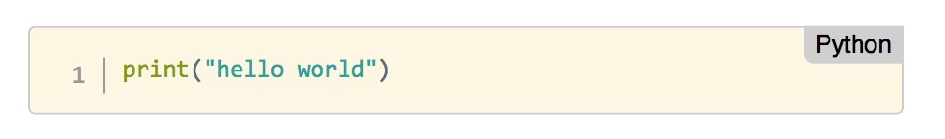
Python Programming
Let us what a Python program looks like.
Starting with the typical "Hello World!" program:
In essence, we are writing code to print the message "Hello World!" in the screen.
A very very simple program: one line of code that will print the string 'Hello World!.
It is easy to read and understand.

Slide 32
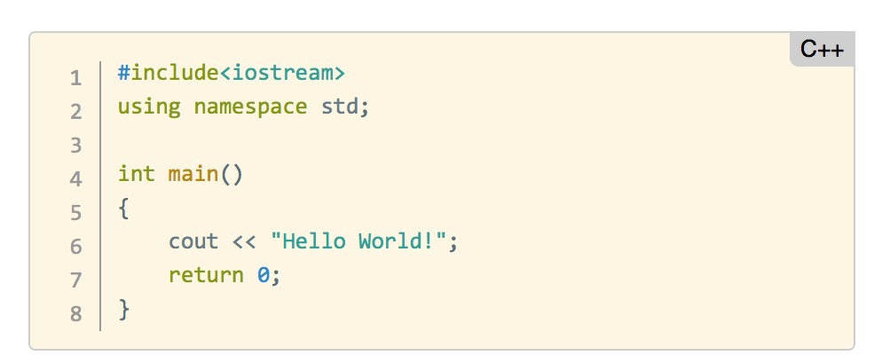
Python Programming
Let’s see the C++ version:
It does exactly the same thing, but it requires us to write a lot more information!
Notes:
Instructor Note:
Here we need to define a main function; however, we have to be careful with the use of punctuation (notice the semicolons at the end of some of the lines) and “cout” is not very understandable in lay terms.
Note: You are encouraged to use other specific examples of an element python does particularly well, using a simple statement or function. This depends on your familiarity with other programming languages, as well with the abilities of the students in your class.

Slide 33
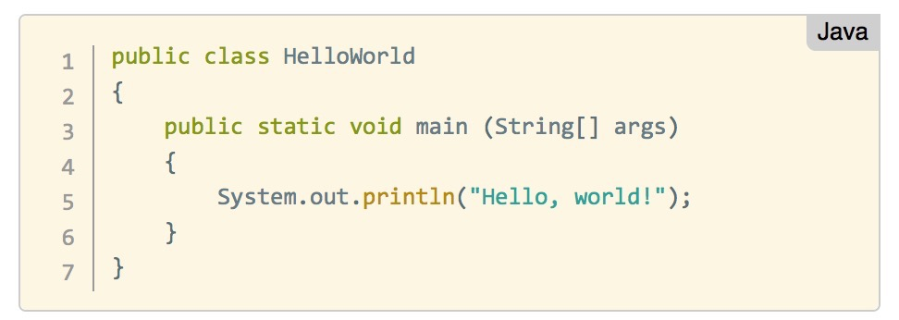
Python Programming
What about Java?
Once again, it does exactly the same, but it takes a lot more code!
Notes:
Instructor Note:
Notice that in the Java version, we define the code inside the context of a “class”.
You are encouraged to use other specific examples of an element python does particularly well, using a simple statement or function. This depends on your familiarity with other programming languages, as well with the abilities of the students in your class.

Slide 34
CLASS
In Object Oriented Programming, a class is a template definition of the methods and variables in a particular kind of object.
In other words, an object is a specific instance of a class
The object contains actual values instead of variables.

Slide 35
Python: Interactive shells v scripts
In our “Hello World!” python program, we are assuming that we are using an interactive shell,
In other words, we are writing code that is executed immediately by the Python interpreter.
We are able to "interact" with the results of the commands we pass. We can do this using a:
Python shell
iPython shell
Jupyter notebook

Slide 36
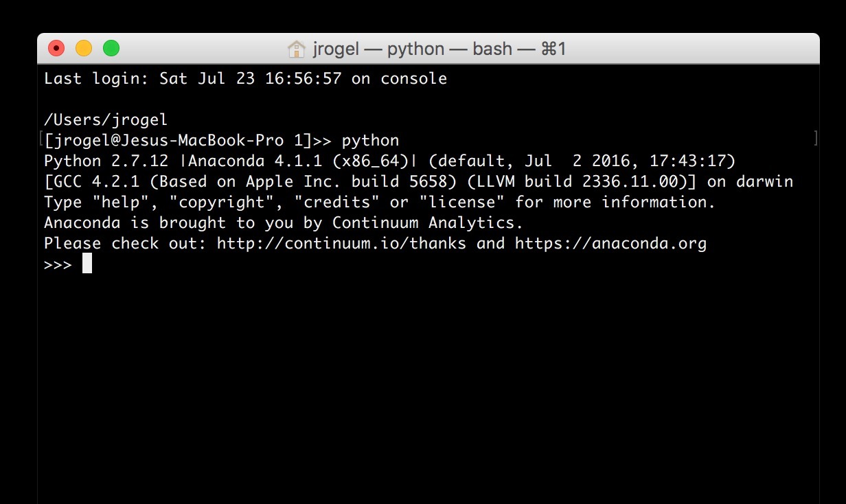
Python Shell
A python shell is similar to a Command Line Terminal and it can be launched by typing:
“python”

Slide 37
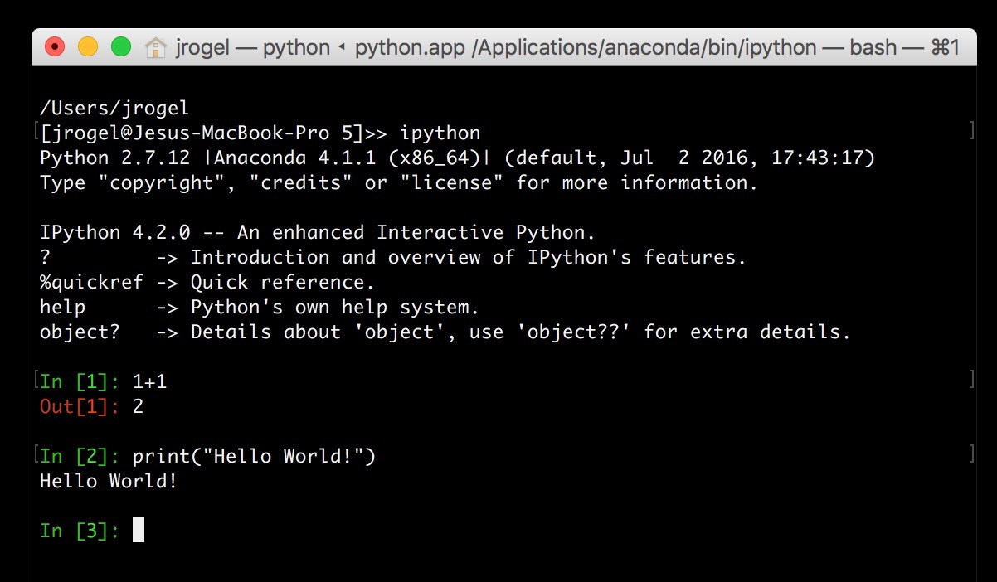
python shell
A python shell is more interesting than a plain terminal, providing syntax coloring and shortcuts to interact with our code. It can be launched with:
“ipython"

Slide 38
Python: Interactive shells v scripts
Sometimes we do not need to interact with our Python code.
Instead, we may want to execute a program and simply get results.
In those cases, we need to create a Python script.
To do so, we can use a text editor of our choice and save the code in a file with extension “.py”.

Slide 39
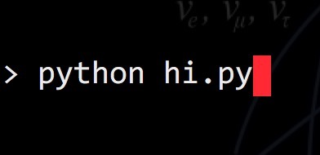
Python script
A barebones script for the "Hello World!" program (saved to a file called `hi.py`) looks like this:
To run the script by passing it as a command to the Python interpreter we need to write:

Slide 40
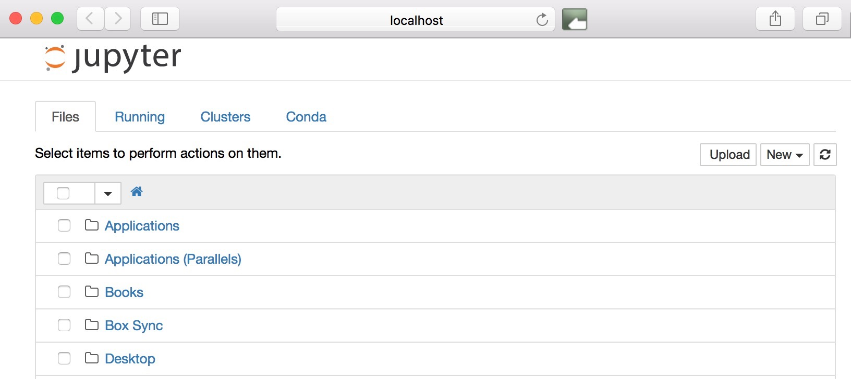
Jupyter notebook
A Jupyter notebook is a web interface that let’s us use formatting along side our code. It is the extremely common and very useful! You can launch it by typing:
“jupyter notebook”

Slide 41
SCRIPT EDITORS and IDE
Some common plain text editors include:
Atom
NotePad (Win), NotePad++ (Win)
TextEdit (Mac), TextWrangler (Mac).
Nano (Linux, Mac)

Slide 42
SCRIPT EDITORS and IDE
Integrated development environments (IDEs) provide comprehensive facilities for computer programmers involved in software development.
PyCharm
Eclipse with PyDev
Atom
Spyder (included in Anaconda)

Slide 43
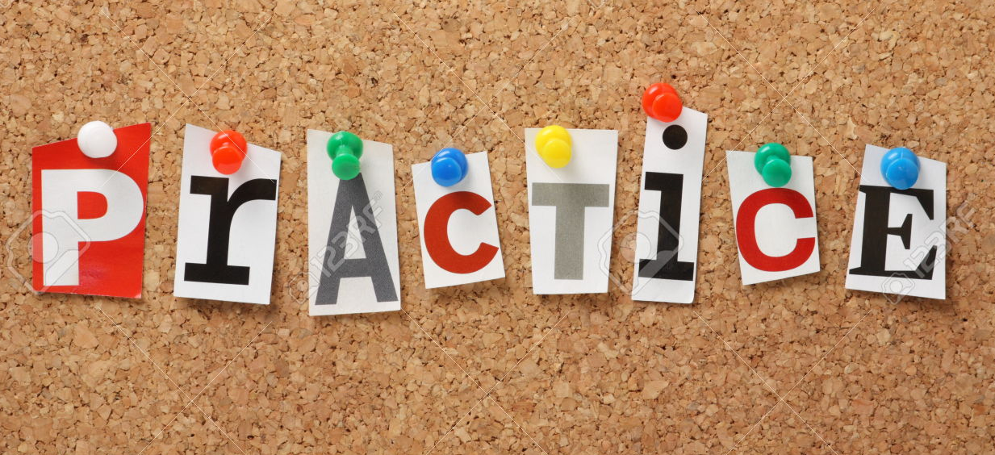
Instructions
We recommend using a Jupyter notebook for this practice.
Open Jupyter: in a terminal type: `jupyter notebook`
Navigate to an appropriate folder where your work will be saved
On the top-right-hand-side click in the button called "New" and select "Python 2” or “Root” (depending on your installation of Python)
Voilà, you are ready to type the commands we will cover

Slide 44
Let’s DO IT
Start Jupyter
Write a snippet that says “Hello World”

Slide 45
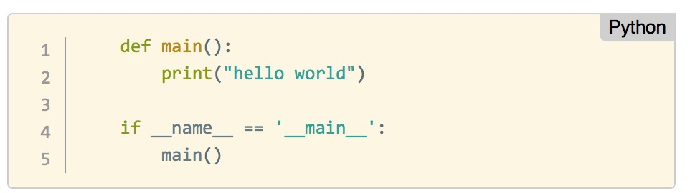
Python script
Unlike other languages, there's no main() function that gets run automatically
the main() function is implicitly all the code at the top level.
A more sophisticated version of the “Hello World!” program is as follows:
Notes:
NOTE: This slide is for advanced programming audiences only.
In this case, the top-level code is an if block. `__name__` is a built-in variable which evaluates to the name of the current module.

Slide 46
Python BASICS
Variables, types, assignment
Using modules

Slide 47
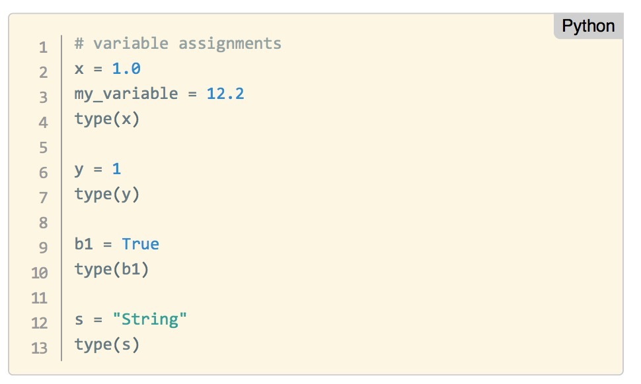
Types, Variables, assignment
Like any other programming language, we need to use types and variables and be able to assign values to them

Slide 48
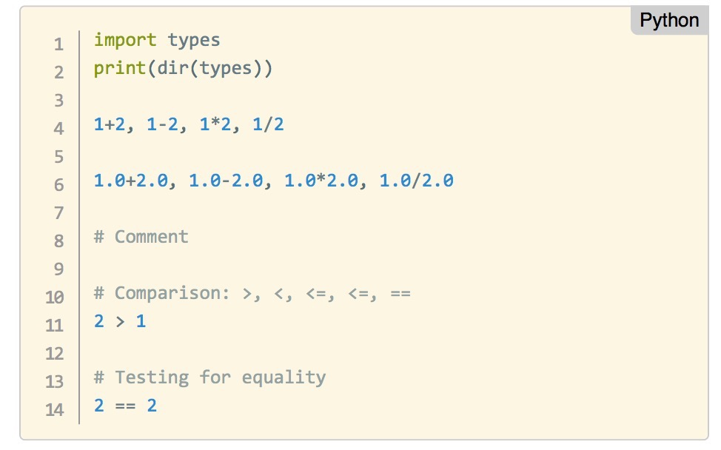
Your turn
Try the following in your Jupyter Notebook:

Slide 49
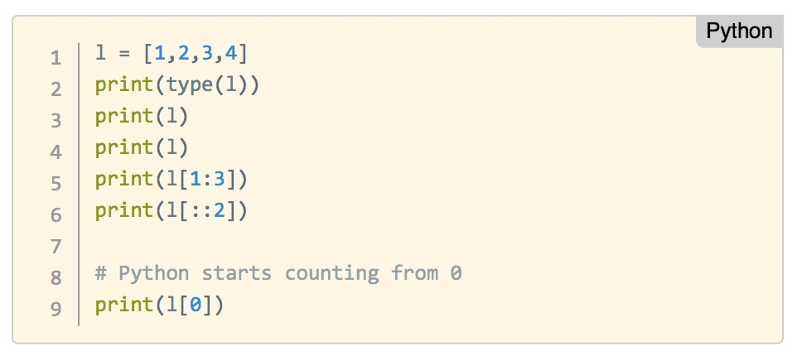
Lists
Lists are collections of objects
They can be changed

Slide 50
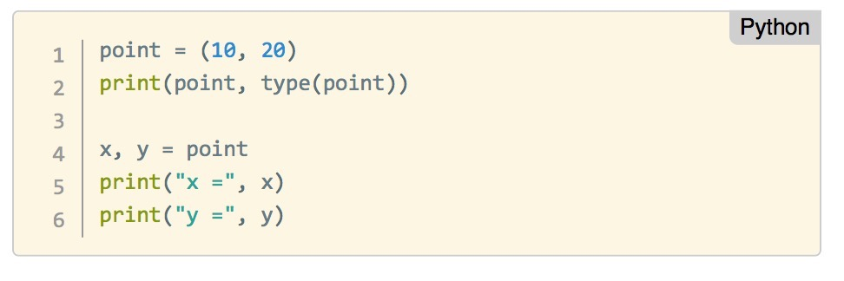
Tuples
Tuples are very similar to lists, but
They cannot be changed

Slide 51
Dictionaries
Dictionaries combine keys with values in pairs
Like in a dictionary, you can search the keys to obtain their corresponding value

Slide 52
DUCK TYPING
If it quacks, it’s a duck
Therefore my son’s phone is a duck
If you can iterate over it, and you can select elements from it, you can use it as a list
It might not actually be a list though, but that’s OK.

Slide 53
FIVE HANDY FUNCTIONS

Slide 54
Let’s DO IT
Add up the numbers from 1 to 100
(The correct answer is 5050.)

Slide 55
GUIDED PRACTICE
Installing & Configuring Common Python Libraries
Notes:
20m

Slide 56
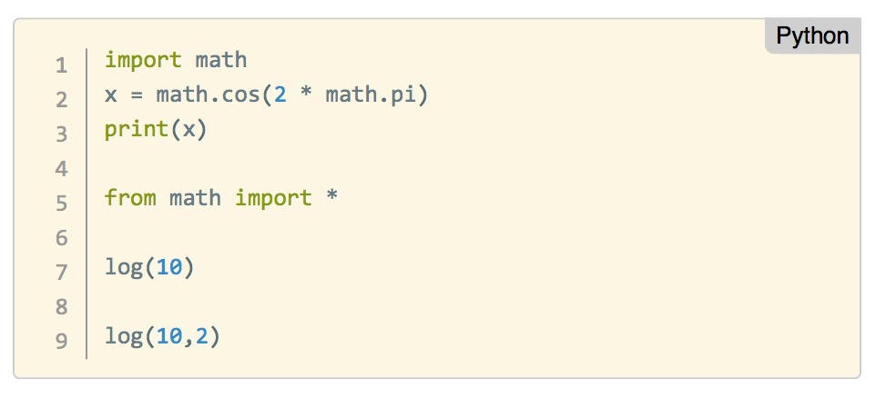
Importing a module
We need to import the functionality of packages and modules before we can use them
Here we import the “math” module to use mathematical functions:

Slide 57
Packages
Libraries of code written to solve particular set of problems
Can be installed with: pip install <package name> or conda install <package name>
Ever used Excel? How do you fancy working with data structured in a similar way, but better graphics and less hassle? Try pandas
Does your application require the use of advanced mathematical or numerical operations using arrays, vectors or matrices? Try SciPy (scientific python) and NumPy (numerical python)

Slide 58
Packages
Libraries of code written to solve particular set of problems
Can be installed with: pip install <package name> or conda install <package name>
Does your application require the use of advanced mathematical or numerical operations using arrays, vectors or matrices? Try SciPy (scientific python) and NumPy (numerical python)

Slide 59
Packages
Are you interested in using python in a data science workflow to exploit machine learning in your applications? Look no further than Scikit-learn
Are you tired of boring-looking charts? Are you frustrated looking for the right menu to move a label in your plot? Take a look at the visuals offered by matplotlib or seaborn

Slide 60
Packages
Is your boss asking about significance testing and confidence intervals? Are you interested in descriptive statistics, statistical tests, or plotting functions? Well statsmodels offers you that and more.
All the data you require is available freely on the web but there is no download button and you need to scrape the website? You can extract data from HTML using Beautiful Soup

Slide 61
Packages
Do you want to write the next awesome artificial intelligence program that kinda sorta understands written texts? Try nltk or spaCey

Slide 62
Let’s DO IT
!pip install seaborn
import seaborn

Slide 63
Python programming 101
BREAK

Slide 64
DEMO
Drawing graphs in python
Notes:
20m

Slide 65
Sample data - jupYter notebook code

Slide 66
Sample data - jupYter notebook code
Jupyter command
Display images inline in the notebook

Slide 67
Sample data - jupYter notebook code
Python code
Import two modules
Most of the time you’ll see import pandas as pd because programmers are lazy
Both of these modules (pandas and matplotlib) are not part of the standard Python install
pip install pandas ; pip install matplotlib

Slide 68
Sample data - jupYter notebook code
Python code
Call the function “read_csv” in the pandas module
Filename to read = ‘sydney-yearly-data.csv’
Make the first column of the CSV file be an index
Store the result in the name “climate”

Slide 69
Sample data - jupYter notebook code
Draw a pretty graph of all the columns of data in “climate”

Slide 70
DEMO
VisualiZing data
Is it important?
When is it needed?
What does it add?
What tools do you use?
Notes:
Instructor Note: This demo is intended to show the students some of the visualization capabilities of Python.
The code in the file Python101Demo_Plotly.ipynb may be more intricate than you may want the students to grasp on their own. We suggest giving the students a copy of the complete notebook above and run through the code with them in class.
Make sure the students understand that this is a demo and that some of the instructions in the demo will become clearer as the lesson progresses. It will also give them an opportunity to continue their learning process.
DISCUSSION
Start by asking the students about the importance of visualizing data: when is it needed? what does it add? what tools do they tend to use in their daily work (if any)?
Instructor Note: Start a Jupyter notebook and remind the students how to use it.

Slide 71
DEMO
VisualiZing data
Is it important?
When is it needed?
What does it add?
What tools do you use?
Notes:
Instructor Note: This demo is intended to show the students some of the visualization capabilities of Python.
The code in the file Python101Demo_Plotly.ipynb may be more intricate than you may want the students to grasp on their own. We suggest giving the students a copy of the complete notebook above and run through the code with them in class.
Make sure the students understand that this is a demo and that some of the instructions in the demo will become clearer as the lesson progresses. It will also give them an opportunity to continue their learning process.
DISCUSSION
Start by asking the students about the importance of visualizing data: when is it needed? what does it add? what tools do they tend to use in their daily work (if any)?
Instructor Note: Start a Jupyter notebook and remind the students how to use it.

Slide 72
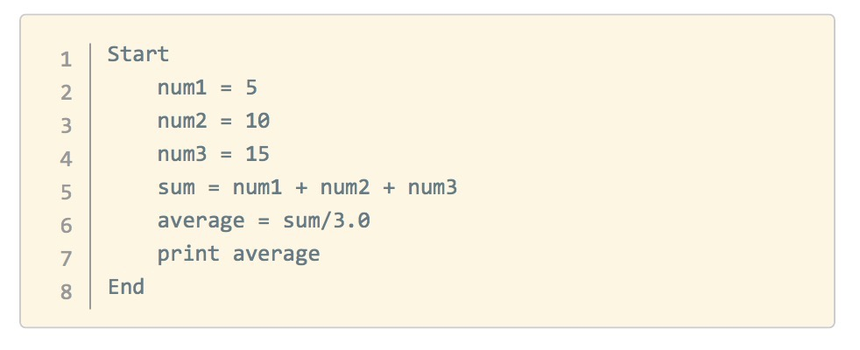
Pseudocode
Pseudocode allows us to represent a program concisely.
The only thing you need is a statement to show where you are starting and where you are ending a program.
Calculate and print the average of three numbers: 5, 10, and 15.
Notes:
Instructor Note:
Run through the following example with the students. Then ask them to tackle problems similar to the ones proposed below.

Slide 73
activity: Write your own (pseudo)code
DIRECTIONS
Create some pseudocode for the following tasks
Create a short script that will calculate the area circle with radius r.
Calculate and print the square of a number. If the number is larger than 10 also calculate the cube.
List the letters in the sentence "Python is awesome"
deliverable
Pseudocode explaining the necessary steps to achieve one of the tasks above
Notes:
Remember, they shouldn’t know what they’re going to design yet, since you can’t know what the solution is before you know the problem.
Share out (15m)
ASK: What are some topics people are interested in?
Instructor will facilitate a discussion around topics, may want to write them on the whiteboard.
Note: This is a great opportunity to nudge students away from some topics that may be too broad in scope, or too unsubstantial a topic.

Slide 74
INTRODUCTION
Python CONTROL STRUCTURES
Notes:
15m

Slide 75
Instructions
We recommend using a Jupyter notebook for this practice.
Open Jupyter: in a terminal type: `jupyter notebook`
Navigate to an appropriate folder where your work will be saved
On the top-right-hand-side click in the button called "New" and select "Python 2” or “Root” (depending on your installation of Python)
Voilà, you are ready to type the commands we will cover
Notes:
Instructor Note: Remind the students about the concepts learnt in the first part of the workshop. Review the first Python code introduced and the types you have covered.
DISCUSSION
1. Start by surveying what students already know or don't know
2. Then state which fundamentals you are going to cover
3. Give a high level overview of what these fundamentals do (e.g. allow programs to store and remember information, etc)
Instructor Note: Start a Jupyter notebook and remind the students how to use it.

Slide 76
Python Programming fundamentals
Understanding core programming concepts and why they are used is just as important as knowing how to write code.
Before we start,we’ll review some basic programming concepts:
Variables: A symbolic name that stores a value (some specific piece of information). Variables have different types.
For example: r = 3

Slide 77
Python Programming fundamentals
Control Structures: A block of programming that analyses variables and chooses a direction in which to go based on given parameters.
The term flow control details the direction the program takes (which way program control “flows”). It determines how a computer will respond when given certain conditions and parameters. Some typical structures include:
if statement
for loop
Functions
Notes:
> Instructor Note: Remind the students about the concepts learnt in the first part of the workshop. Review the first Python code introduced and the types you have covered.
DISCUSSION
1. Start by surveying what students already know or don't know
2. Then state which fundamentals you are going to cover
3. Give a high level overview of what these fundamentals do (e.g. allow programs to store and remember information, etc)
Instructor Note: Start a Jupyter notebook and remind the students how to use it.

Slide 78
Python Programming fundamentals
Data Structures: Data structure is a particular way of storing and organizing data in a computer so that it can be used efficiently. Some examples include:
Lists
Tuples
Arrays
Matrices
Dataframes
Notes:
> Instructor Note: Remind the students about the concepts learnt in the first part of the workshop. Review the first Python code introduced and the types you have covered.
DISCUSSION
1. Start by surveying what students already know or don't know
2. Then state which fundamentals you are going to cover
3. Give a high level overview of what these fundamentals do (e.g. allow programs to store and remember information, etc)
Instructor Note: Start a Jupyter notebook and remind the students how to use it.

Slide 79
Python Programming fundamentals
Syntax: The syntax of a programming language is the set of rules that define the combinations of symbols that are considered to be correctly structured programs in that language
The interrelationship of all of these elements make it possible for us to write programs to implement algorithms and solve problems
Notes:
> Instructor Note: Remind the students about the concepts learnt in the first part of the workshop. Review the first Python code introduced and the types you have covered.
DISCUSSION
1. Start by surveying what students already know or don't know
2. Then state which fundamentals you are going to cover
3. Give a high level overview of what these fundamentals do (e.g. allow programs to store and remember information, etc)
Instructor Note: Start a Jupyter notebook and remind the students how to use it.

Slide 80
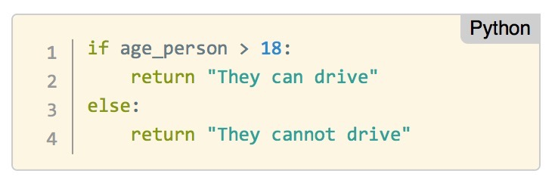
IF
An `if` statement is a conditional structure that, if proved true, performs a function or displays information.
Think of this as a decision that moves the flow of your program depending on the answer to a TRUE-FALSE question.
In Python we can write:
Notes:
> Instructor Note: Remind the students about the concepts learnt in the first part of the workshop. Review the first Python code introduced and the types you have covered.
DISCUSSION
1. Start by surveying what students already know or don't know
2. Then state which fundamentals you are going to cover
3. Give a high level overview of what these fundamentals do (e.g. allow programs to store and remember information, etc)
Instructor Note: Start a Jupyter notebook and remind the students how to use it.

Slide 81
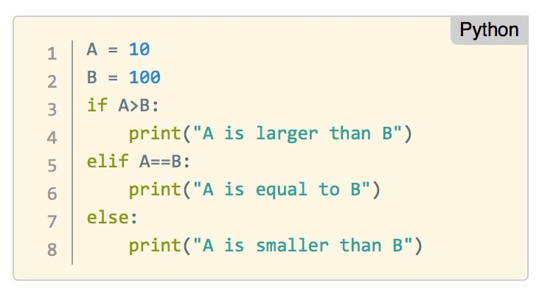
IF
Another example:
Notes:
> Instructor Note: Remind the students about the concepts learnt in the first part of the workshop. Review the first Python code introduced and the types you have covered.
DISCUSSION
1. Start by surveying what students already know or don't know
2. Then state which fundamentals you are going to cover
3. Give a high level overview of what these fundamentals do (e.g. allow programs to store and remember information, etc)
Instructor Note: Start a Jupyter notebook and remind the students how to use it.

Slide 82
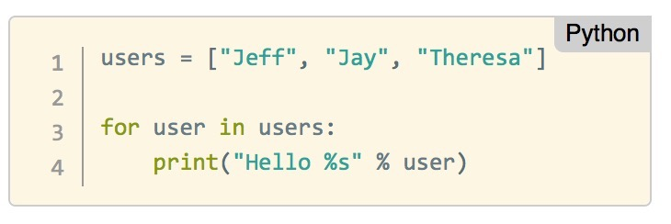
for loop
A loop statement in programming performs a predefined set of instructions or tasks while or until a predetermined condition is met.
In Python we can write:
Which is the same as writing:
Notes:
> Instructor Note: Remind the students about the concepts learnt in the first part of the workshop. Review the first Python code introduced and the types you have covered.
DISCUSSION
1. Start by surveying what students already know or don't know
2. Then state which fundamentals you are going to cover
3. Give a high level overview of what these fundamentals do (e.g. allow programs to store and remember information, etc)
Instructor Note: Start a Jupyter notebook and remind the students how to use it.

Slide 83
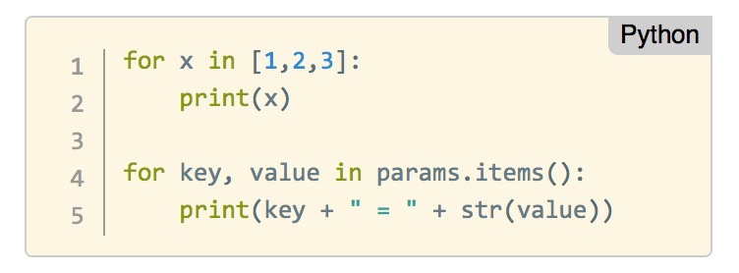
for loop
Let us see other examples. Can you explain what the program is doing?
Notes:
> Instructor Note: Remind the students about the concepts learnt in the first part of the workshop. Review the first Python code introduced and the types you have covered.
DISCUSSION
1. Start by surveying what students already know or don't know
2. Then state which fundamentals you are going to cover
3. Give a high level overview of what these fundamentals do (e.g. allow programs to store and remember information, etc)
Instructor Note: Start a Jupyter notebook and remind the students how to use it.

Slide 84
WEIRD THINGS ABOUT for loopS
There isn’t an initialiser-condition-iterator (as in Java, Perl, C or C++)
You can break out or carry on with break or continue
You can have a for loop over anything that supports iteration
Lists, Strings, Dictionaries, Generators, Files
You can have an else clause (if we made it to the end without interruption)
Notes:
> Instructor Note: Remind the students about the concepts learnt in the first part of the workshop. Review the first Python code introduced and the types you have covered.
DISCUSSION
1. Start by surveying what students already know or don't know
2. Then state which fundamentals you are going to cover
3. Give a high level overview of what these fundamentals do (e.g. allow programs to store and remember information, etc)
Instructor Note: Start a Jupyter notebook and remind the students how to use it.

Slide 85
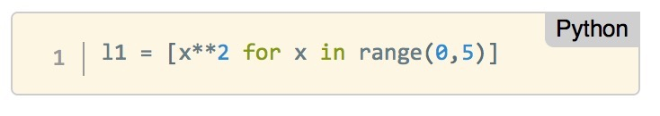
List ComprehensionS
List comprehensions are an elegant way to define and create list in Python. It uses a for loop inside the definition of the list itself.
Let’s take a look at one, and see if you can figure out what is happening:
Notes:
> Instructor Note: Remind the students about the concepts learnt in the first part of the workshop. Review the first Python code introduced and the types you have covered.
DISCUSSION
1. Start by surveying what students already know or don't know
2. Then state which fundamentals you are going to cover
3. Give a high level overview of what these fundamentals do (e.g. allow programs to store and remember information, etc)
Instructor Note: Start a Jupyter notebook and remind the students how to use it.

Slide 86
INCOMPREHENSIBLE STUFF I WRITE ALL THE TIME
List comprehensions can have if statements embedded in them.
% operator in Python means “remainder when divided by”
Means the same as
Notes:
> Instructor Note: Remind the students about the concepts learnt in the first part of the workshop. Review the first Python code introduced and the types you have covered.
DISCUSSION
1. Start by surveying what students already know or don't know
2. Then state which fundamentals you are going to cover
3. Give a high level overview of what these fundamentals do (e.g. allow programs to store and remember information, etc)
Instructor Note: Start a Jupyter notebook and remind the students how to use it.

Slide 87
Let’s DO IT
How many times does the letter ’s' appear in “the sixth sick sheik’s sixth sick sheep”?
Use a jupyter cell
Create a variable called “tongue twister” with the sentence in it
You can use a for loop or a list comprehension:
If you want to use a for loop:
Create a variable with the count of f’s seen so far.
Use another variable to iterate over the tongue twister (that’s your for loop)
In the loop, increment the count of f’s seen so far if you encounter a letter ‘f’
If you want to use a list comprehension:
Take the length of the list formed by iterating over the tongue twister
But filter out everything that isn’t an ‘f’

Slide 88
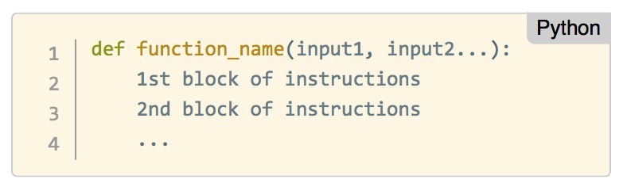
Functions
A function is a group of instructions used by programming languages to return a single result or a set of results.
Functions are a convenient way to divide our code into useful blocks, providing us with order, making the code more readable and reusable.
Here is how you define a function in Python:
Notes:
> Instructor Note: Remind the students about the concepts learnt in the first part of the workshop. Review the first Python code introduced and the types you have covered.
DISCUSSION
1. Start by surveying what students already know or don't know
2. Then state which fundamentals you are going to cover
3. Give a high level overview of what these fundamentals do (e.g. allow programs to store and remember information, etc)
Instructor Note: Start a Jupyter notebook and remind the students how to use it.

Slide 89
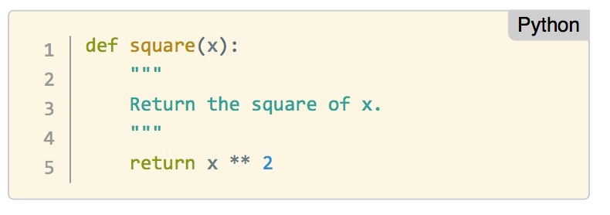
Functions
Let’s define a function that returns the square of the input value. It even has a “““documentation string (docstring)”““ that describe what it does
Notes:
> Instructor Note: Remind the students about the concepts learnt in the first part of the workshop. Review the first Python code introduced and the types you have covered.
DISCUSSION
1. Start by surveying what students already know or don't know
2. Then state which fundamentals you are going to cover
3. Give a high level overview of what these fundamentals do (e.g. allow programs to store and remember information, etc)
Instructor Note: Start a Jupyter notebook and remind the students how to use it.

Slide 90
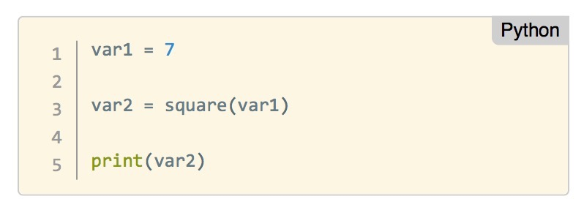
Functions
We can call this function as follows:
Notes:
> Instructor Note: Remind the students about the concepts learnt in the first part of the workshop. Review the first Python code introduced and the types you have covered.
DISCUSSION
1. Start by surveying what students already know or don't know
2. Then state which fundamentals you are going to cover
3. Give a high level overview of what these fundamentals do (e.g. allow programs to store and remember information, etc)
Instructor Note: Start a Jupyter notebook and remind the students how to use it.

Slide 91
DEMO
Writing Programs in Python
Notes:
15m

Slide 92
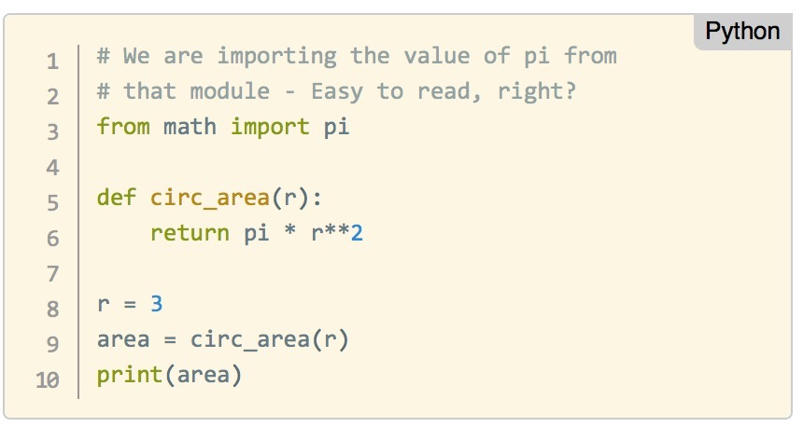
Writing programs in Python
Python is an interpreted language, which means you can run the program as soon as you make changes to the file.
This makes iterating, revising, and troubleshooting programs is much quicker than many other languages.
Let us create a complete program that will calculate the area circle with radius r.
Notes:
Instructor Note: Show the students how to put together a program in Python.
Instructor Note: Walk the students through translating the first pseudocode problem from Part 1 - Independent Practice. Then encourage the students to write Python code for the other two exercises from Part 1 - Independent Practice.

Slide 93
activity: Write your own (pseudo)code
DIRECTIONS
Translate the your pseudocode for the tasks we saw before
Calculate and print the square of a number. If the number is larger than 10 also calculate the cube.
List the letters in the sentence "Python is awesome”
deliverable
Python code that executes the tasks above
Notes:
Ask them to write out pseudocode to attempt to answer these problems.
Share out (15m)
ASK: What are some topics people are interested in?
Instructor will facilitate a discussion around topics, may want to write them on the whiteboard.
Note: This is a great opportunity to nudge students away from some topics that may be too broad in scope, or too unsubstantial a topic.

Slide 94
GUIDED PRACTICE
Real data science code
Pinky swear: nothing in the data science courses is all that hard. Here’s some
real code to play with.
Notes:
20m

Slide 95
Instructions
Let’s open a new Jupyter notebook for this practice.
Work in pairs if you aren’t feeling confident.
Save the file called Python101_Part2_GuidedPractice.ipynb in a known location in your file system
Start Jupyter (jupyter notebook) and navigate to the location where you saved the file
Open the file by clicking on the name
Voilà, you can start the Guided Practice
Notes:
Instructor Note:
Use the Jupyter notebook: Python101Part2GuidedPractice.ipynb
IDE suggestion
We encourage you to use a Jupyter notebook. It makes it easier to keep the class together as students will be using a common IDE.
Activity
We suggest making the code below available to the students and get them to work in pairs going through the code in the notebook

Slide 96
InDEPENDENT PRACTICE
Putting it all Together!
Notes:
20m

Slide 97
What are you interested in?
Python programming 101
Given your interests and knowledge, which are you more interested in learning about:
Practical applications of Python?
Python fundamentals?

Slide 98
Option 2: Python fundamentals
DIRECTIONS
Write Python code to complete the following tasks:
A recipe you are reading states how many grams you need for the ingredient. Unfortunately, your store only sells items in ounces. Create a program to convert grams to ounces. [ounces = (28.3495231)grams]
Read in a Fahrenheit temperature. Calculate and display the equivalent centigrade temperature. The following formula is used for the conversion:
C = (5 / 9) * (F – 32)`
Calculate the amount obtained by investing the principal P for N years at the rate of R. The following formula is used for the conversion:
A = P * (1 + R) ^ N
deliverable
Python code that executes the tasks above
Notes:
Instructor Note:
> Depending on the size and abilities of the class, you can ask students to tackle the tasks individually or in groups.
1. **Individually**: Each student tackles the tasks and discuss the answers in pairs before discussing with the entire class.
2. **Pairs**: Ask the students to answer the problems in pair and discuss the answers with the entire class
3. **For larger classes**, you can split the students into 3 groups and assign one problem per group then have the groups present back how to do it to the rest of the class.

Slide 99
PYTHON PROGRAMMING101
CONCLUSION
Notes:
10m

Slide 100
Review & Recap
In this workshop, we've covered the following topics:
Python as a popular, flexible programming language
Python has applications in many different areas
Python is particularly great for data manipulation
Python programming basics include: types, variables, functions, and more!
Notes:
Instructor Note: Review Topics Covered
Gather some thoughts from the class answering the question above. After a quick discussion, restate learning objectives and describe how we met them.

Slide 101
Learning Plan
Takeaways
Evaluate your python programming skills! How confident are you with:
Python Syntax
Programming Fundamentals
Data Analysis

Slide 102
What SHOULD YOU DO NEXT?
TAKEAWAYS
For beginner programmers:
Go through Learn Python the hard way
Familiarise yourself with the language by going through A Beginner's Python Tutorial

Slide 103
What SHOULD YOU DO NEXT?
TAKEAWAYS
For existing programmers who are new to Python, try these:
Read the information in Moving to Python From Other Languages
Python for java developers
Python for MATLAB users

Slide 104
What SHOULD YOU DO NEXT?
TAKEAWAYS
For anyone looking for a challenge :)
Challenge yourself by tackling the Python Challenge

Slide 105
Want More?
TAKEAWAYS
General Assembly offers courses that use Python! Check out our:
Part-time Data Science Course
Data Science Immersive Course

Slide 106
TEST YOURSELF (PERHAPS LATER)
Let’s open a Jupyter notebook for this practice.
Save the file called Python101_Part2_IndPractice.ipynb in a known location in your file system
Start Jupyter (you know how now) and navigate to the location where you saved the file
Open the file by clicking on the name
Voilà, you can start the Independent Practice
Notes:
In option 1, you can use the Iris Dataset notebook included in the materials to follow up the introduction to pandas in the previous section. N Note that the notebook makes reference to the Iris Dataset included here.
This activity lets the students to see the practical applications of python.

Slide 107
PYTHON PROGRAMMING101
Notes:
Instructor Notes: Encourage the students to share any thoughts or questions before closing the session.

Slide 108
PYTHON PROGRAMMING101
Don’t forget to fill out your exit ticket
Notes:
Exit tickets are quick surveys students complete at the end of each class. It should only take about 5 minutes.

